Slide 1
Mastering Embedded System Online Diploma www.learn-in-depth.com
First Term (Final Project 1 ) Eng. Ibrahim Samir eltbakh My Profile:

Slide 2
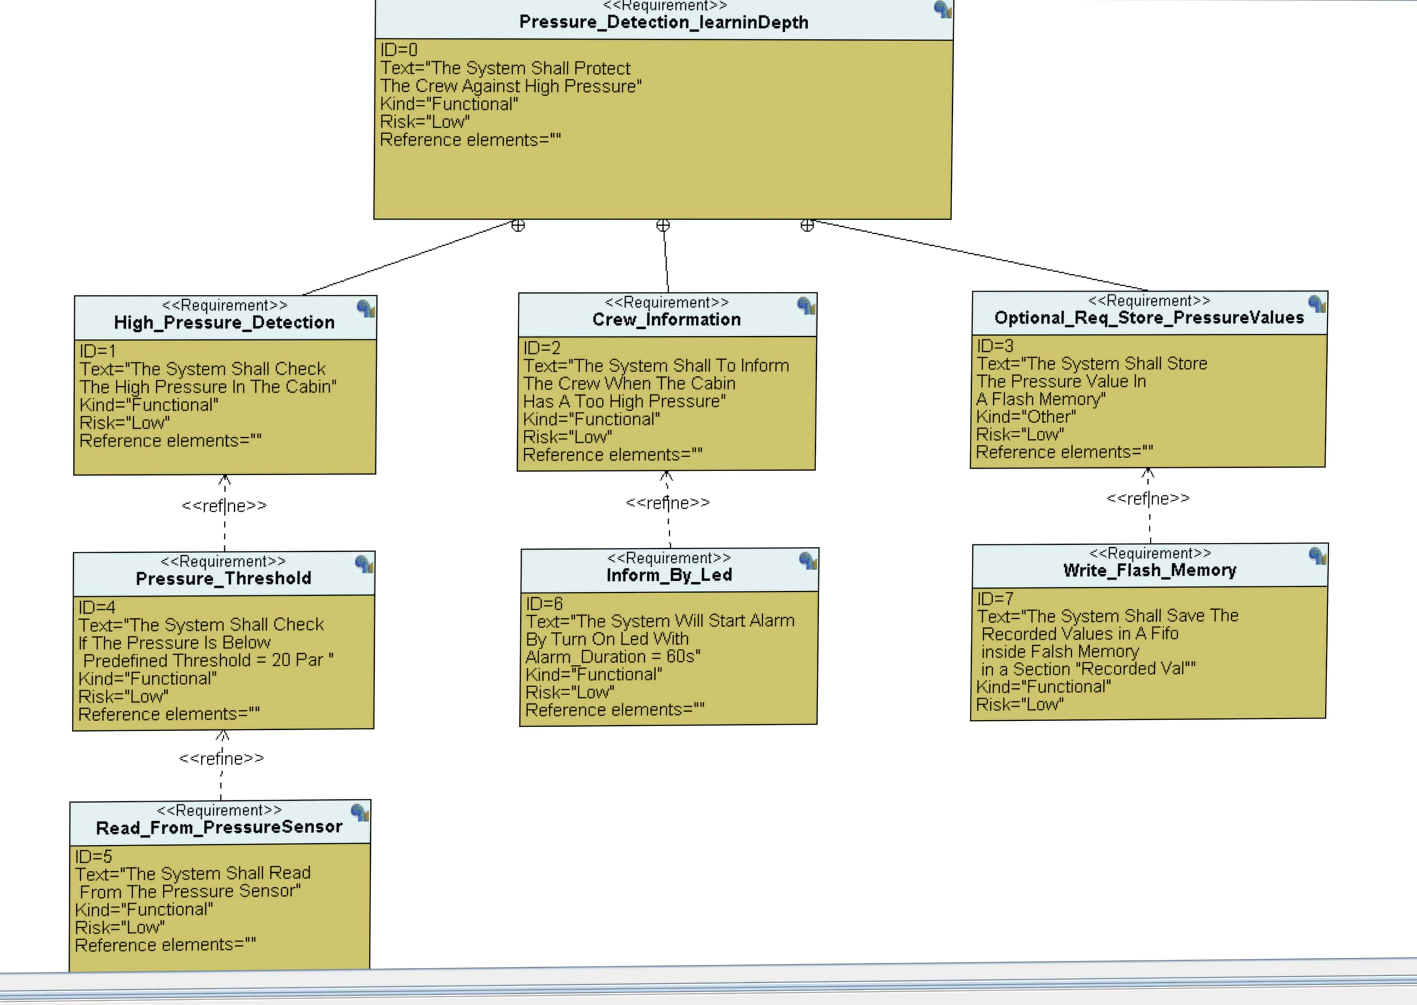
requirements Diagram

Slide 3
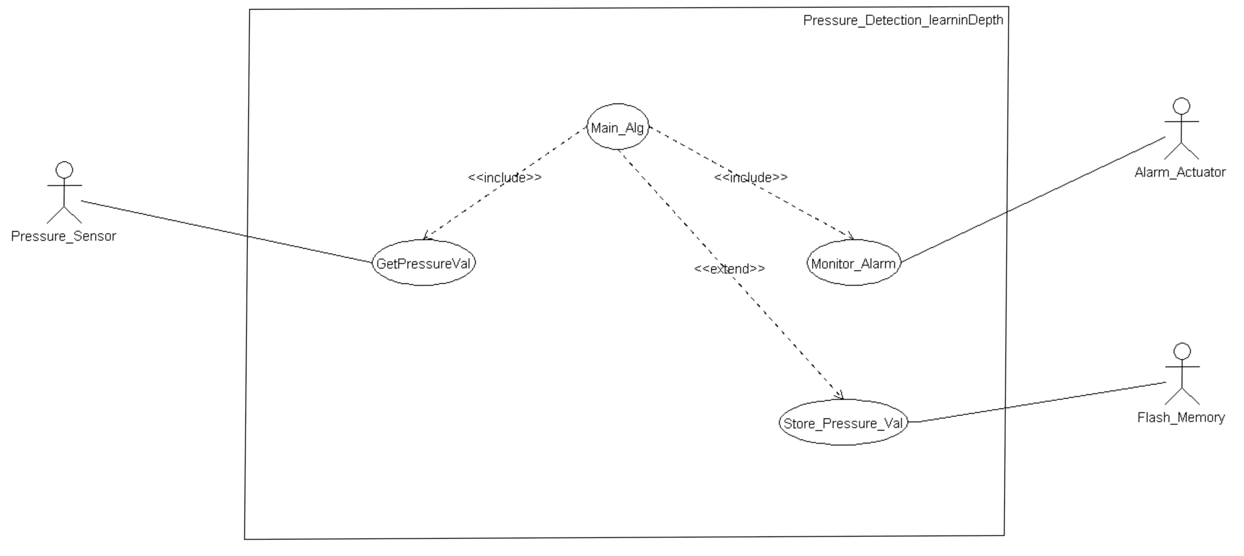
System Analysis
Use Case Diagram

Slide 4
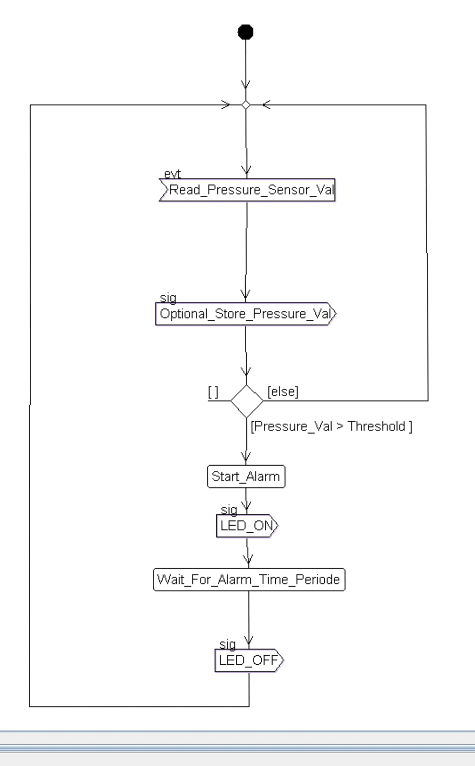
System Analysis
Activity Diagram

Slide 5
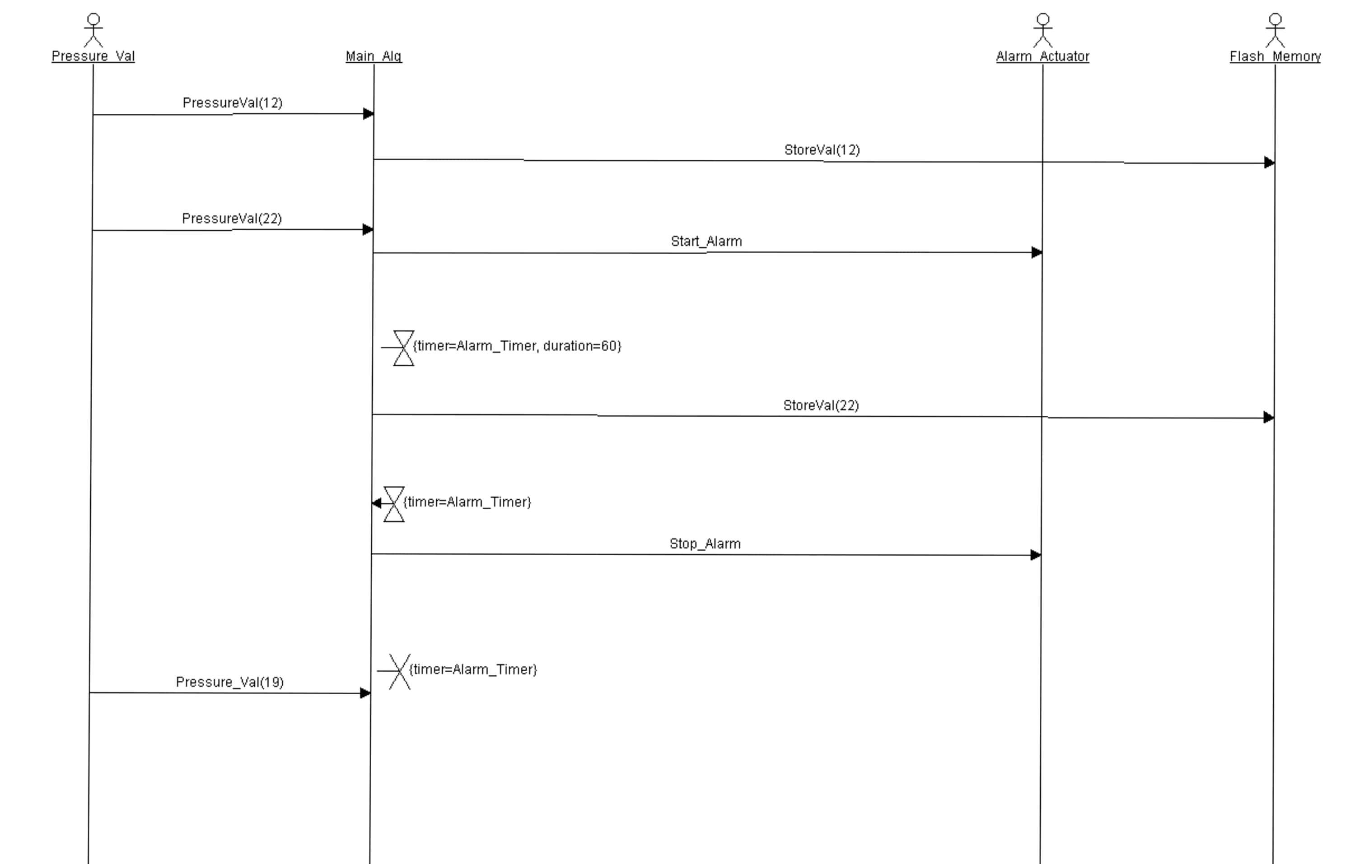
System Analysis
Sequence Diagram

Slide 6
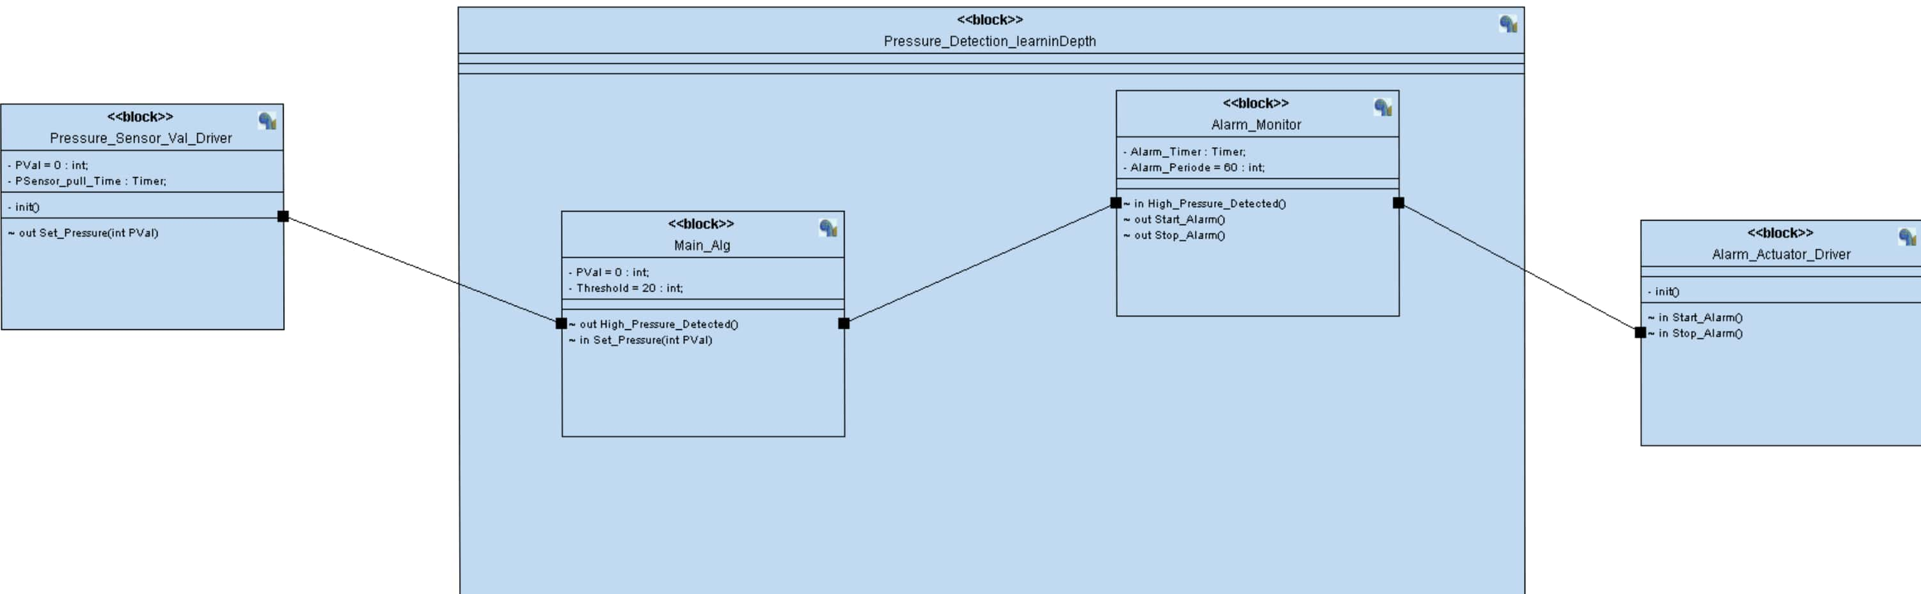
System Design

Slide 7
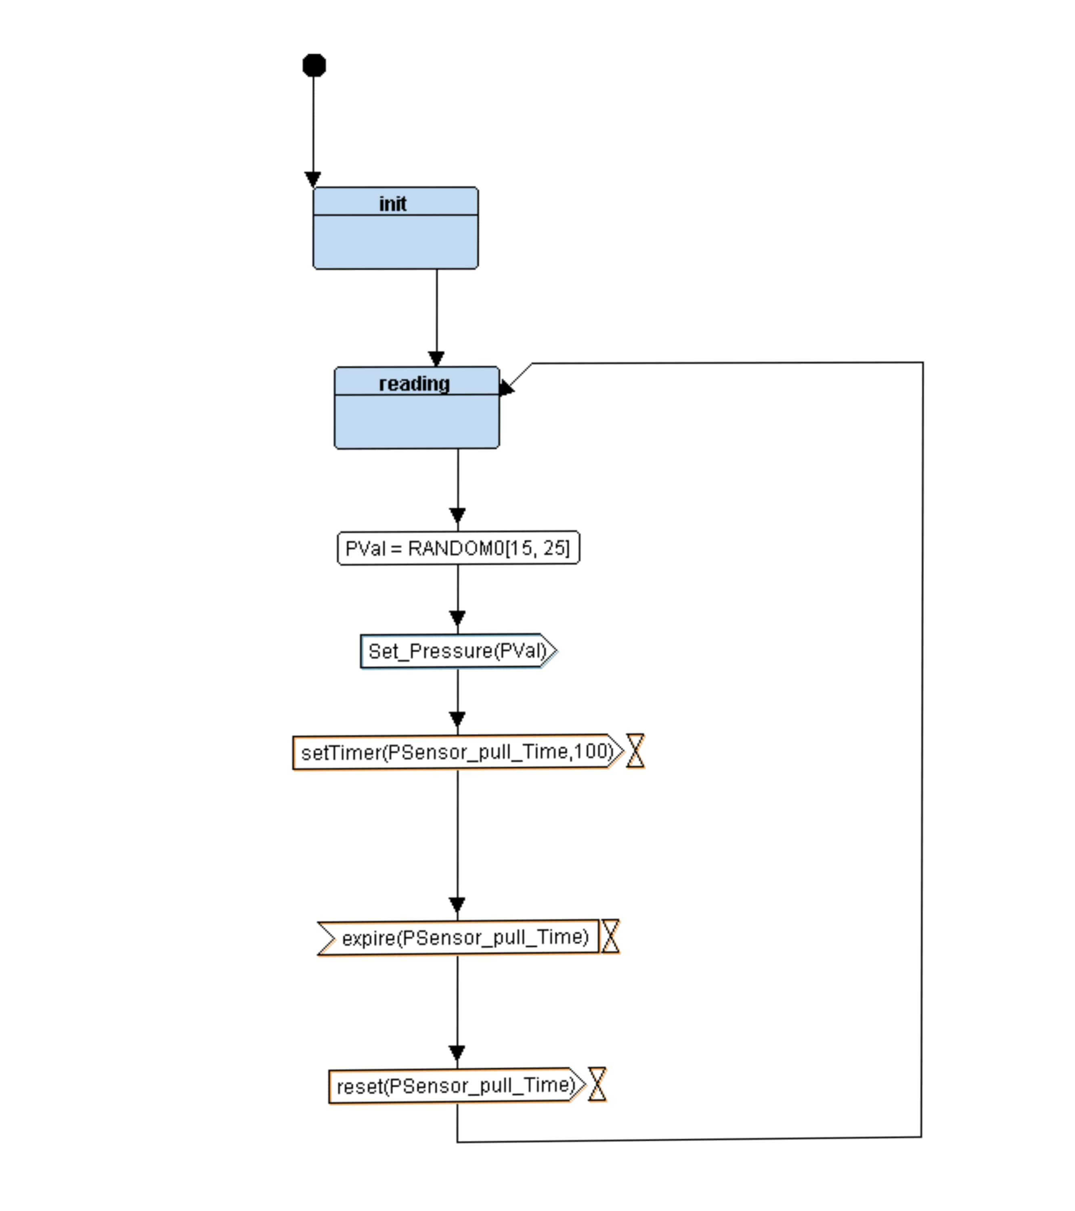
state machine
Pressure_Sensor_Val_Driver

Slide 8
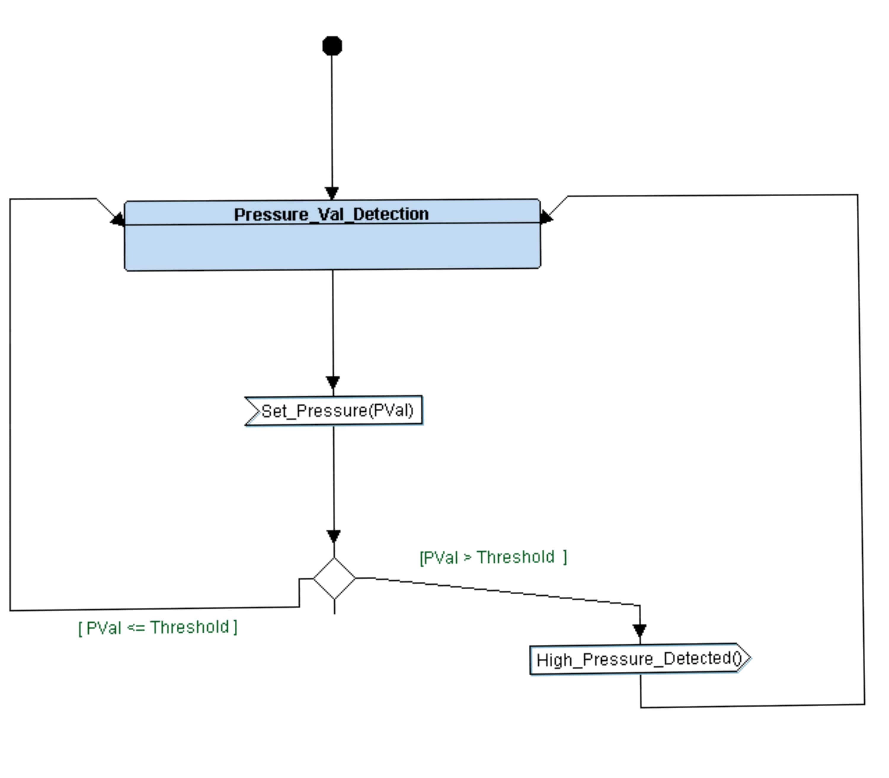
state machine
Main_Alg

Slide 9
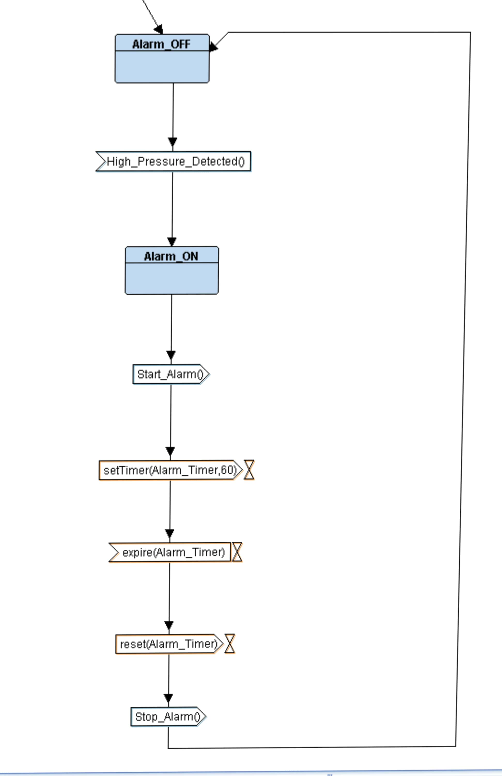
state machine
Alarm_Monitor

Slide 10
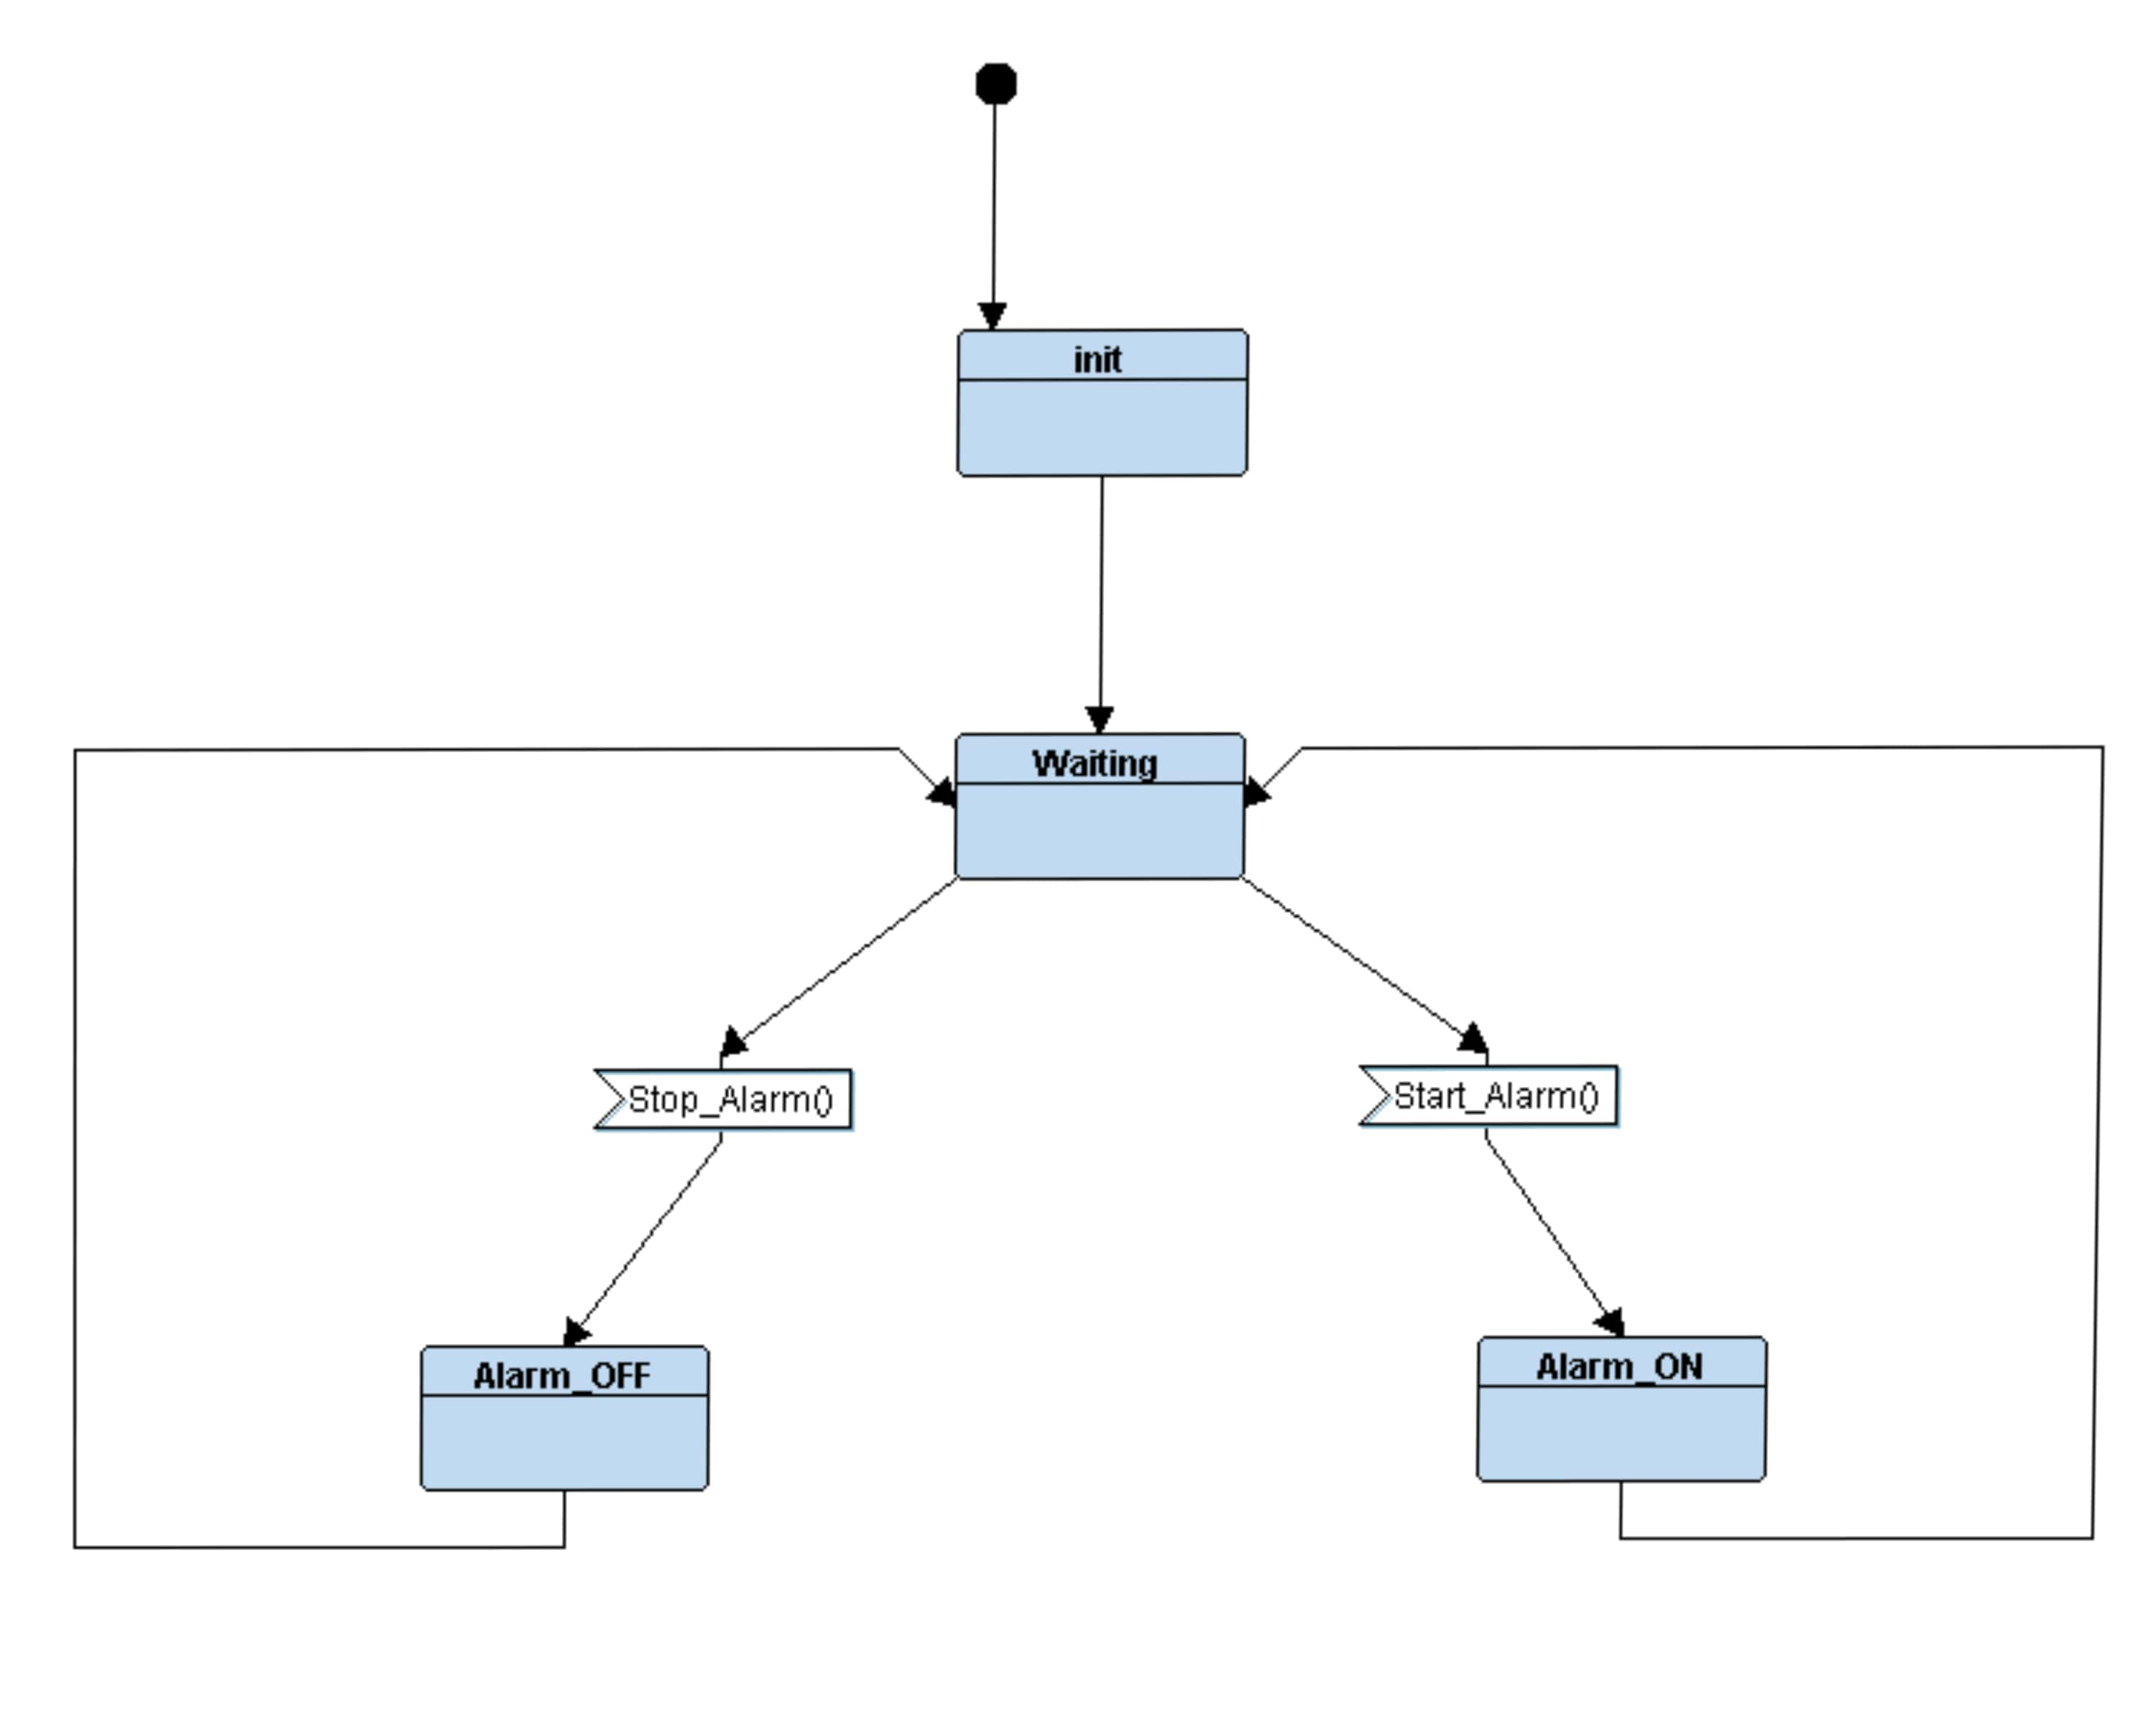
state machine
Alarm_Actuator_Driver

Slide 11
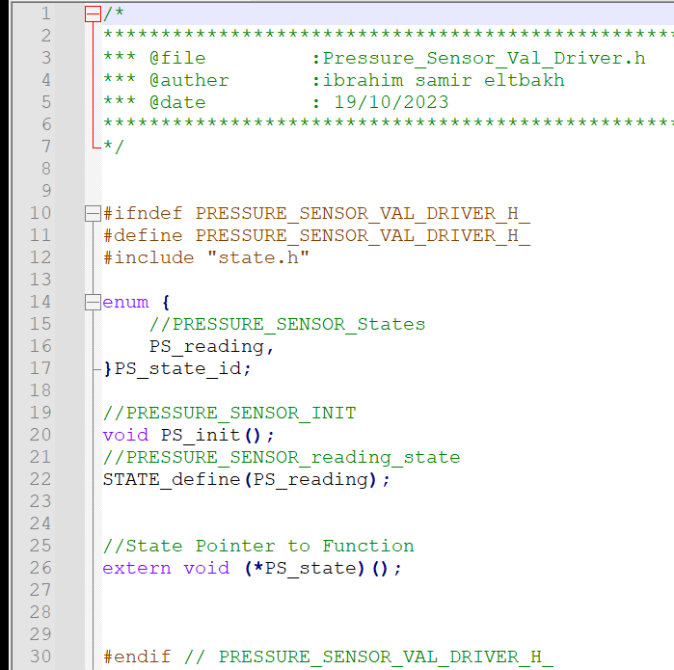
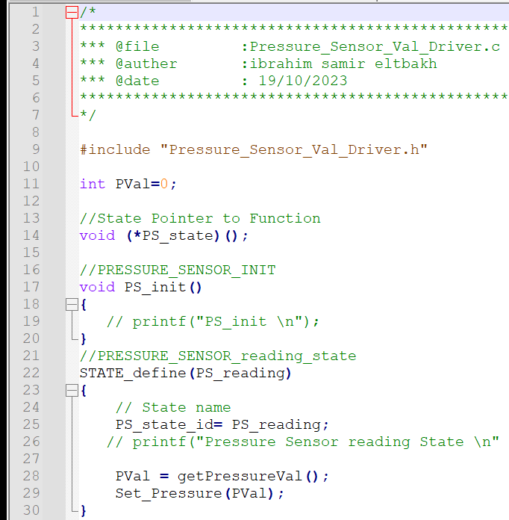
Code for each module
Pressure_Sensor_Val_Driver.h
Pressure_Sensor_Val_Driver.c

Slide 12
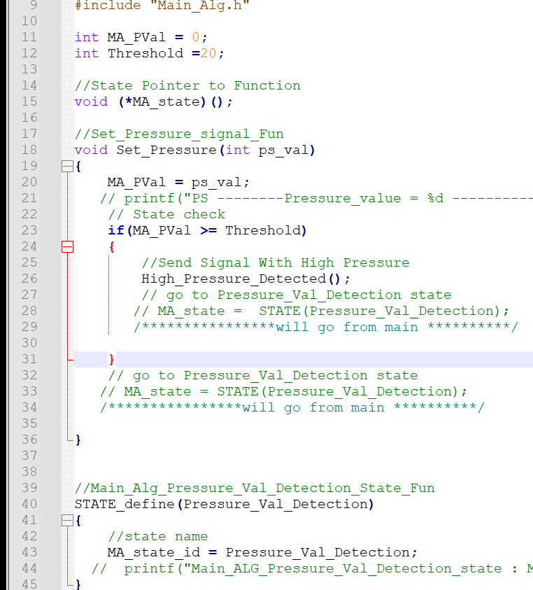
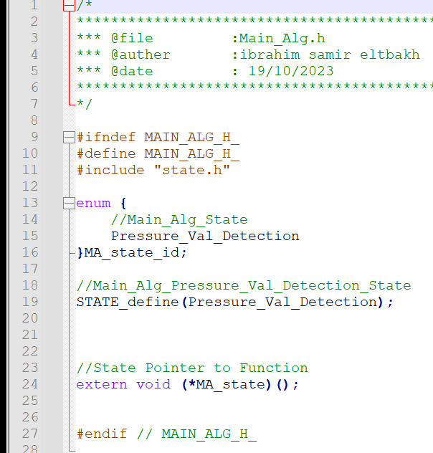
Code for each module
Main_Alg.h
Main_Alg.c

Slide 13
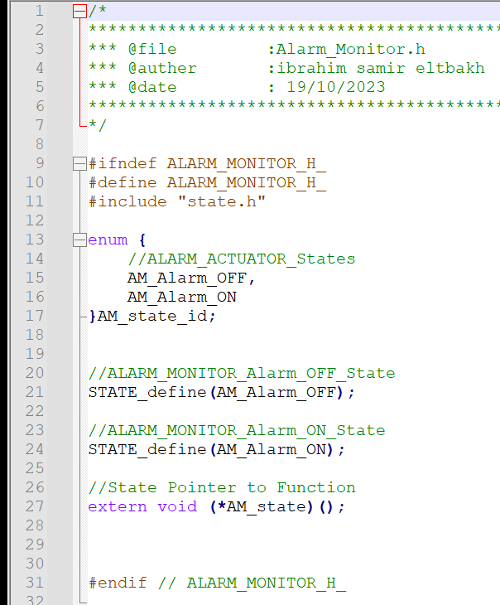
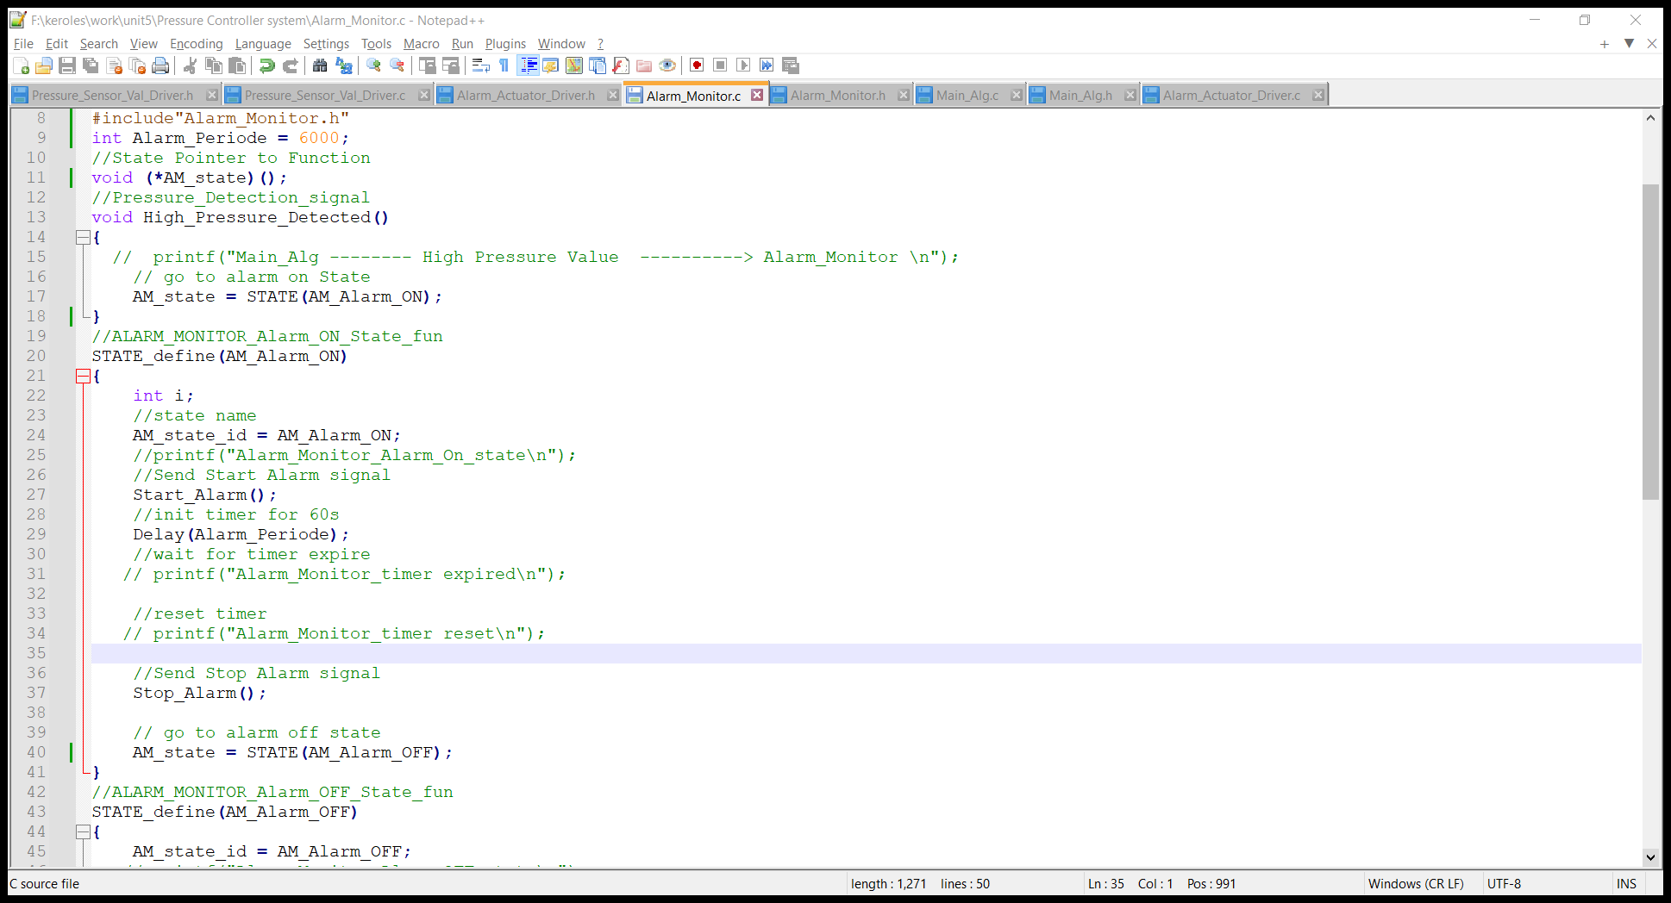
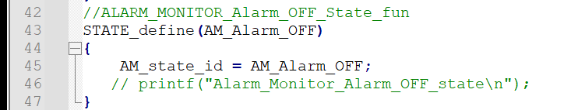
Code for each module
Alarm_Monitor.h
Alarm_Monitor.c

Slide 14
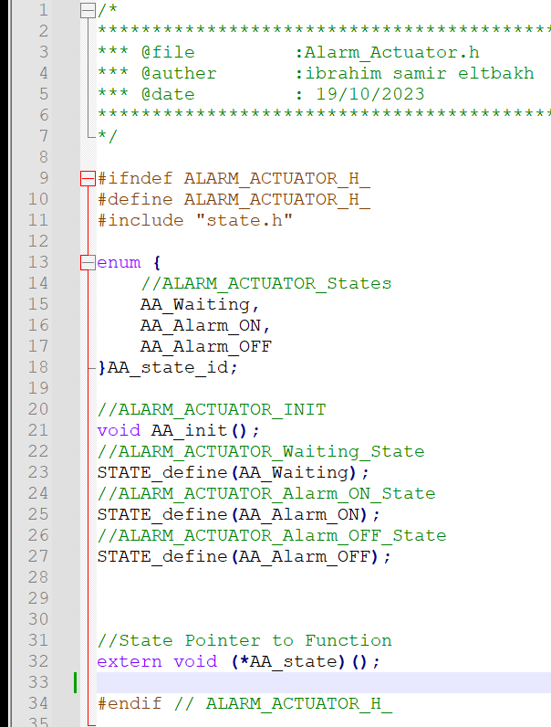
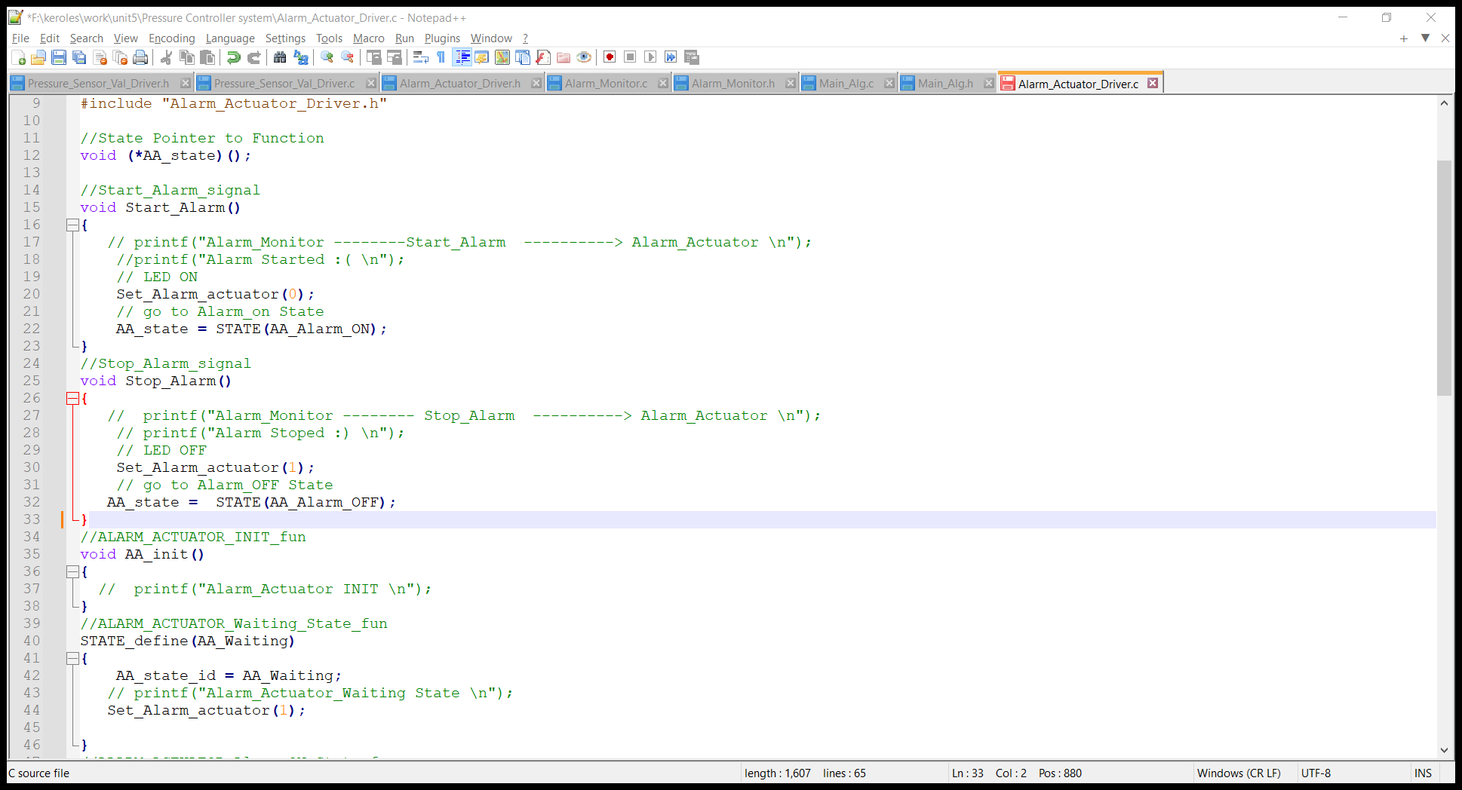
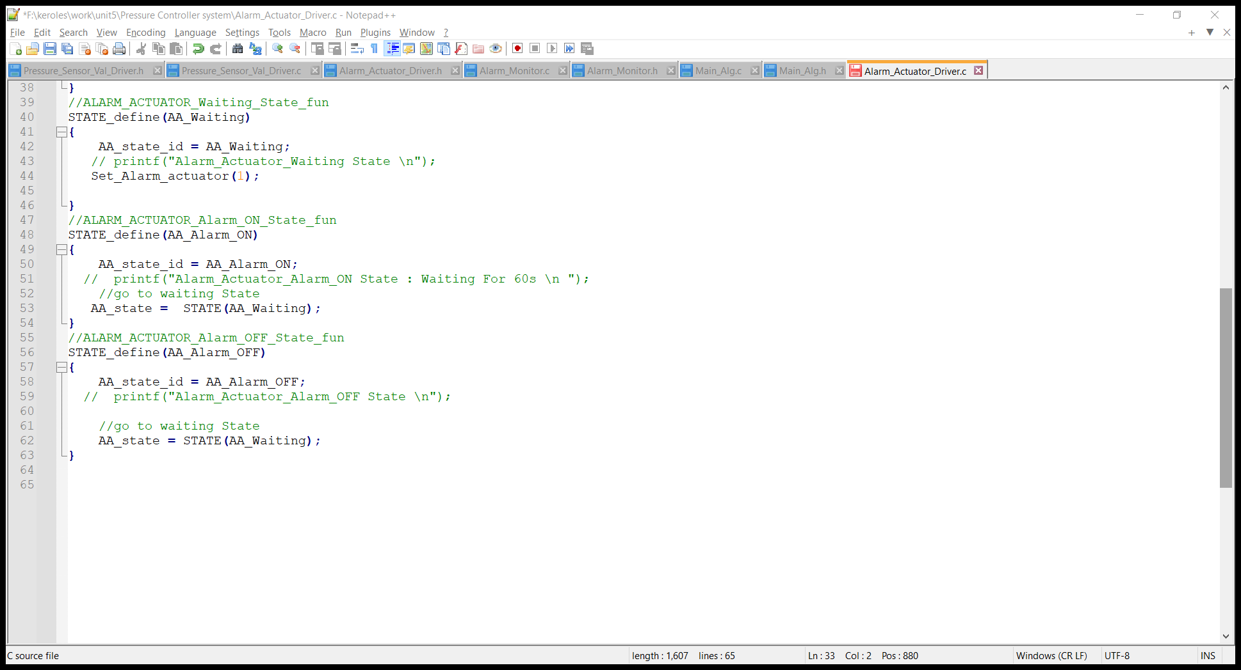
Code for each module
Alarm_Actuator_Driver.h
Alarm_Actuator_Driver.c

Slide 15
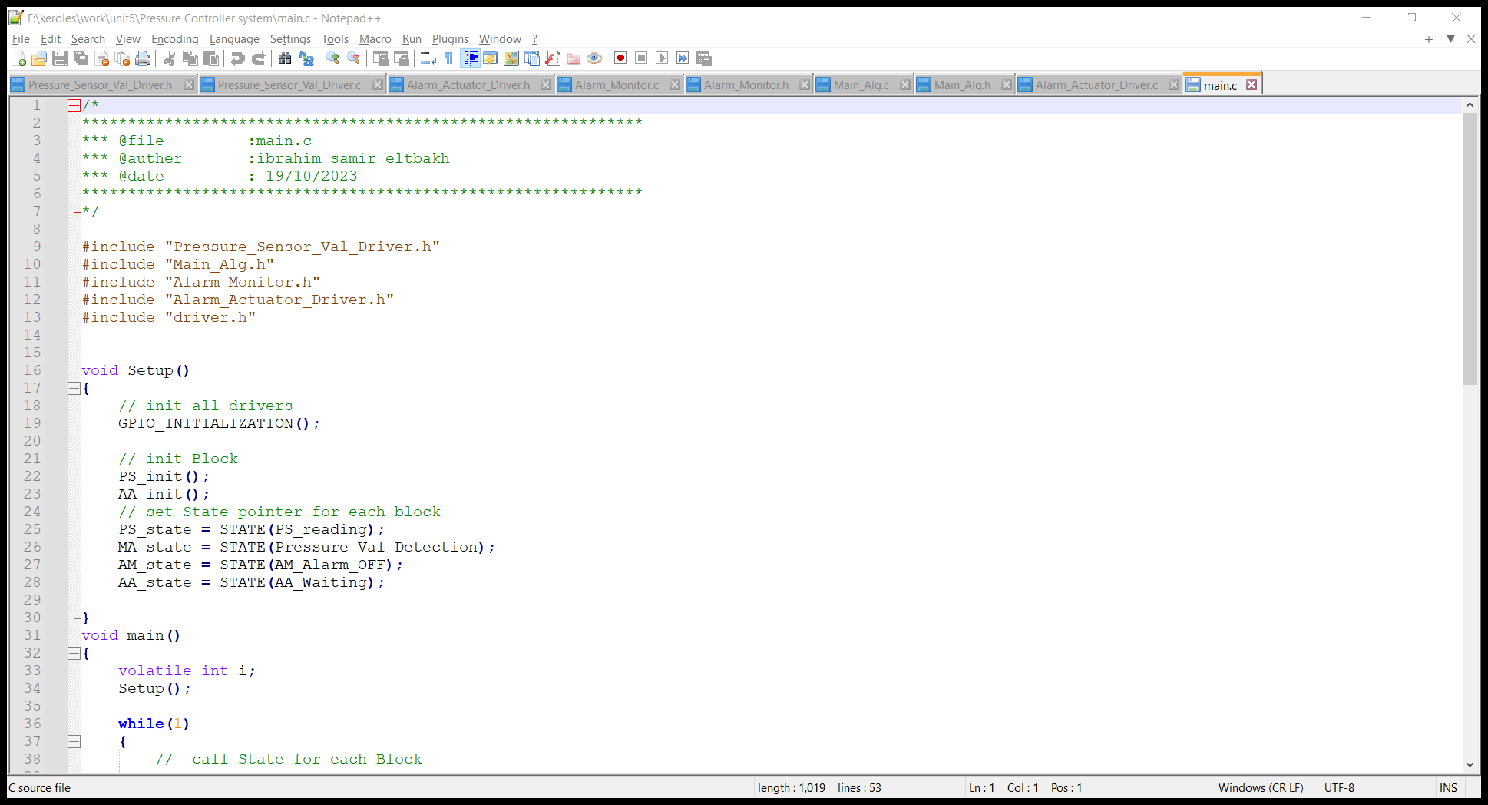
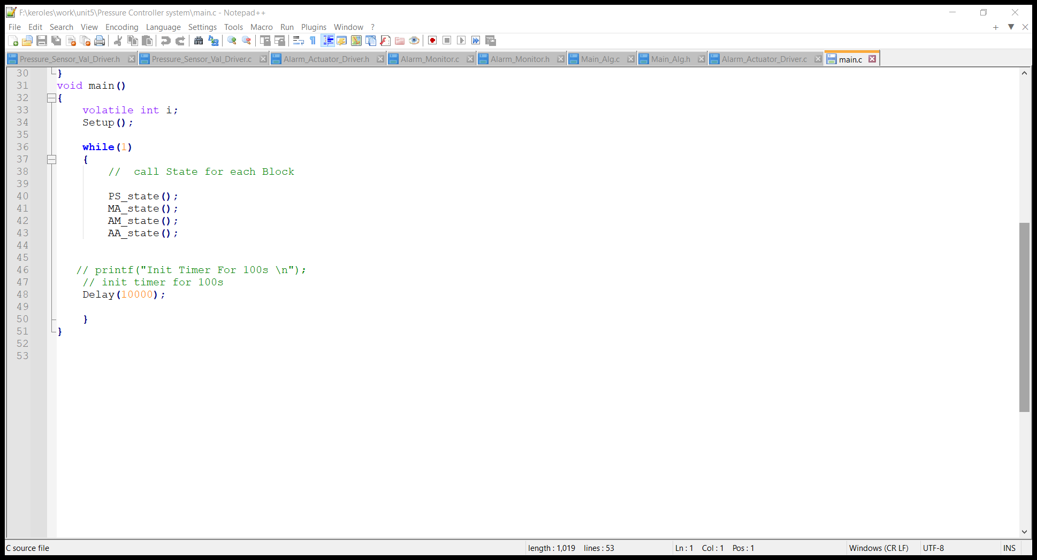
Code for each module
Main

Slide 16
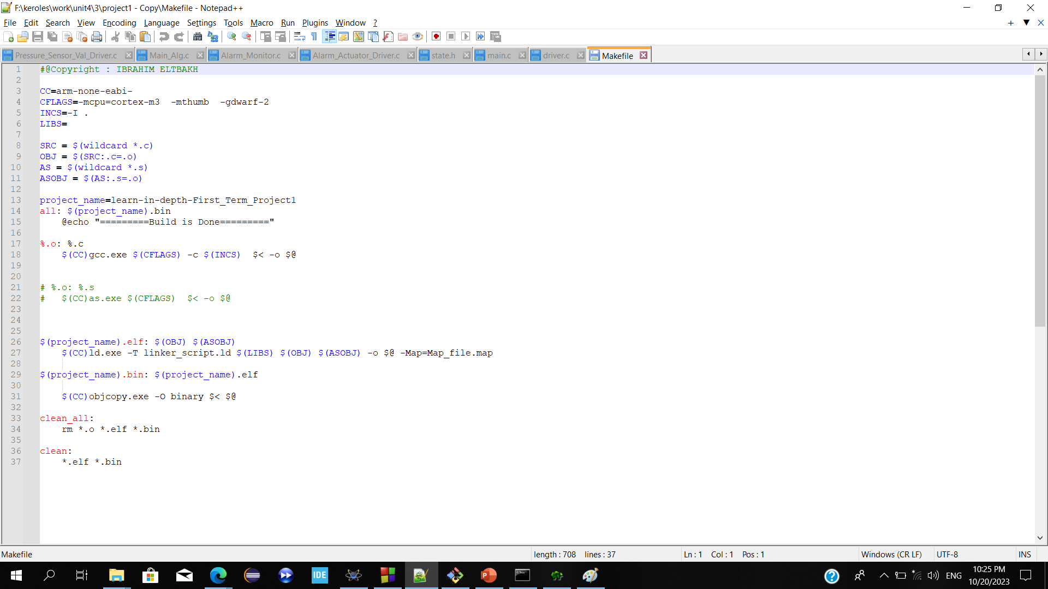
MakeFile

Slide 17
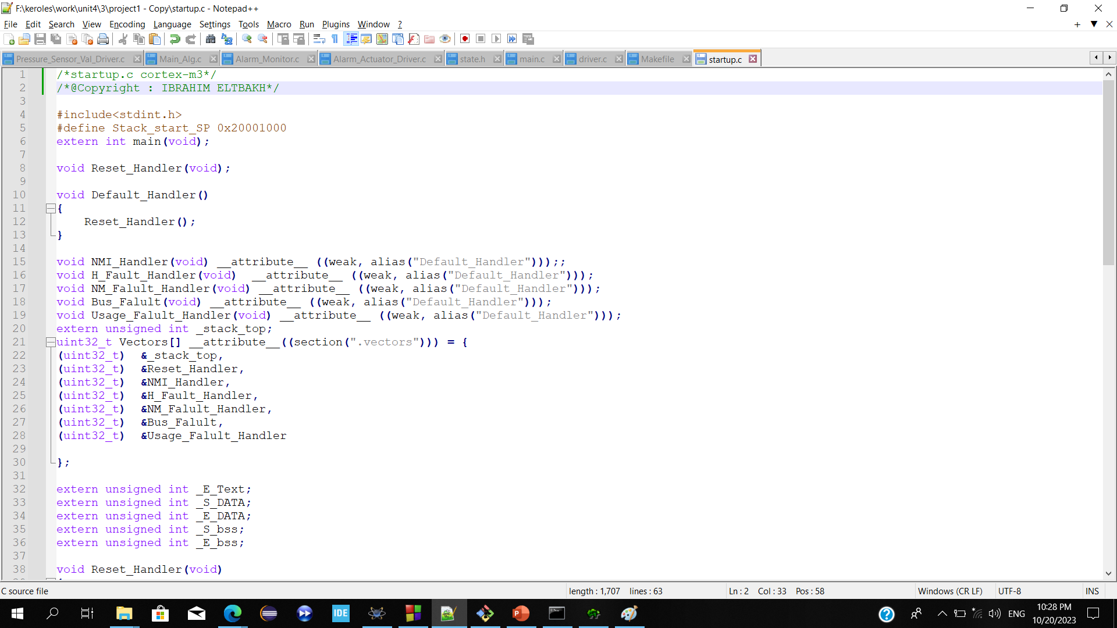
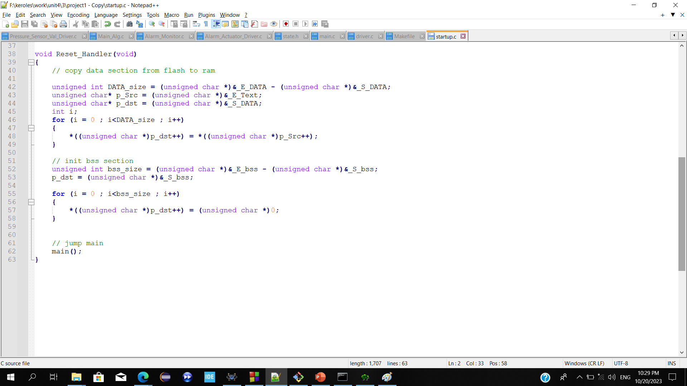
Startup.c

Slide 18
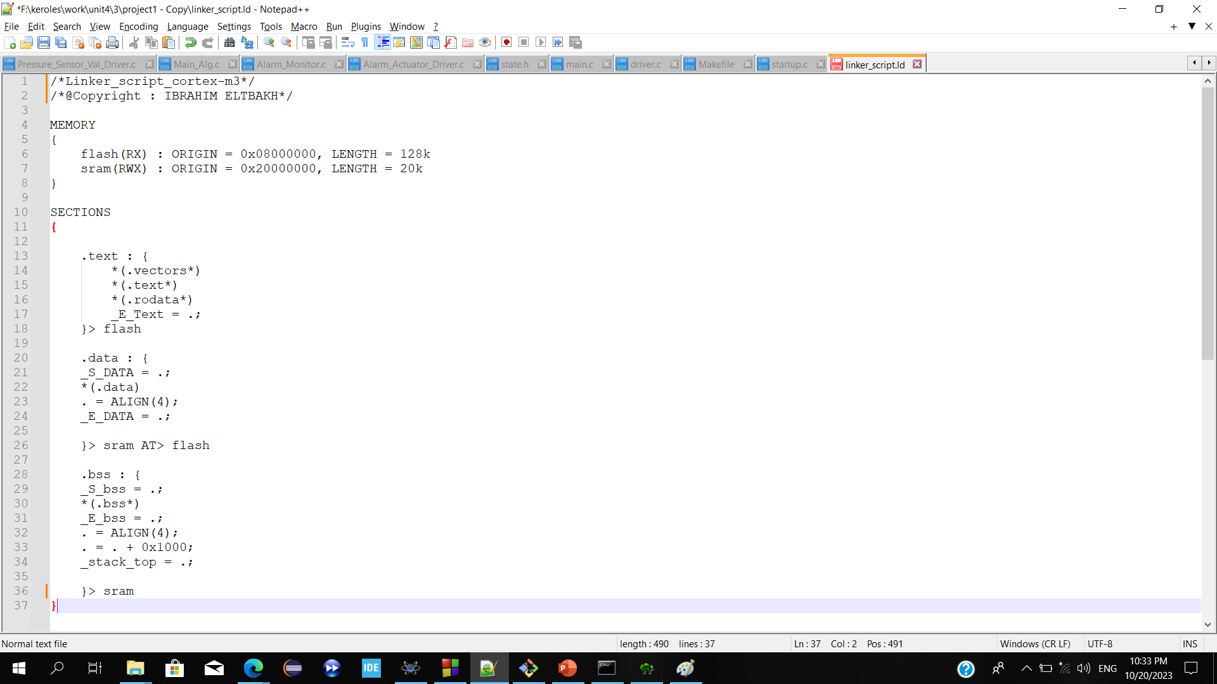
Linker.ld

Slide 19
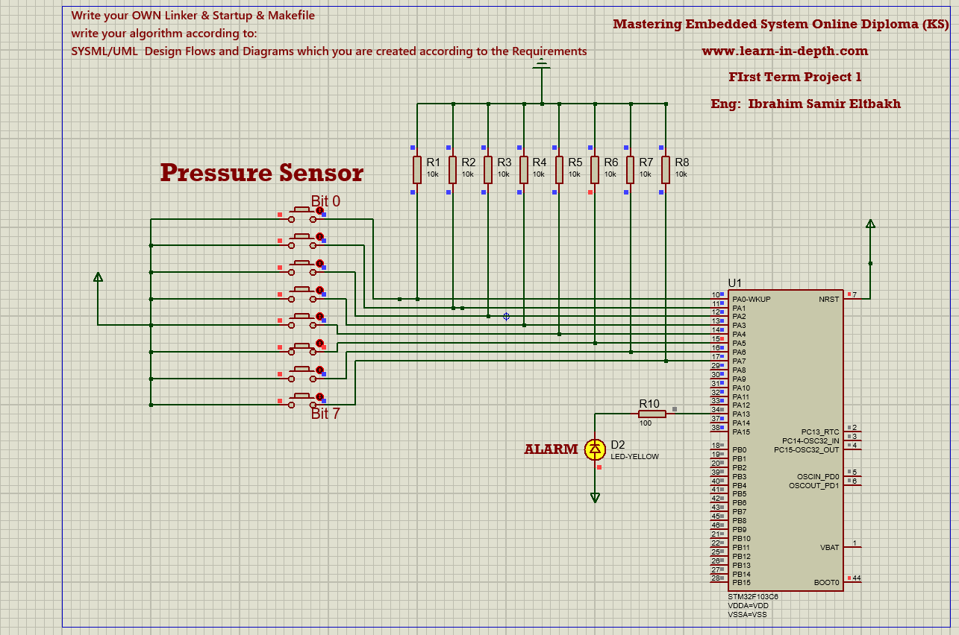
Simulation results
Pressure =32 > 20 Alarm will enabled for 60s

Slide 20
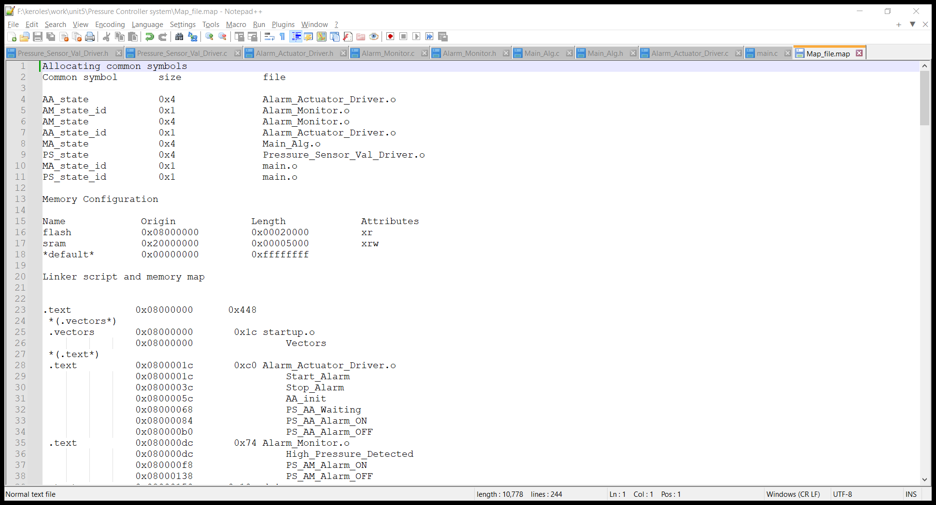
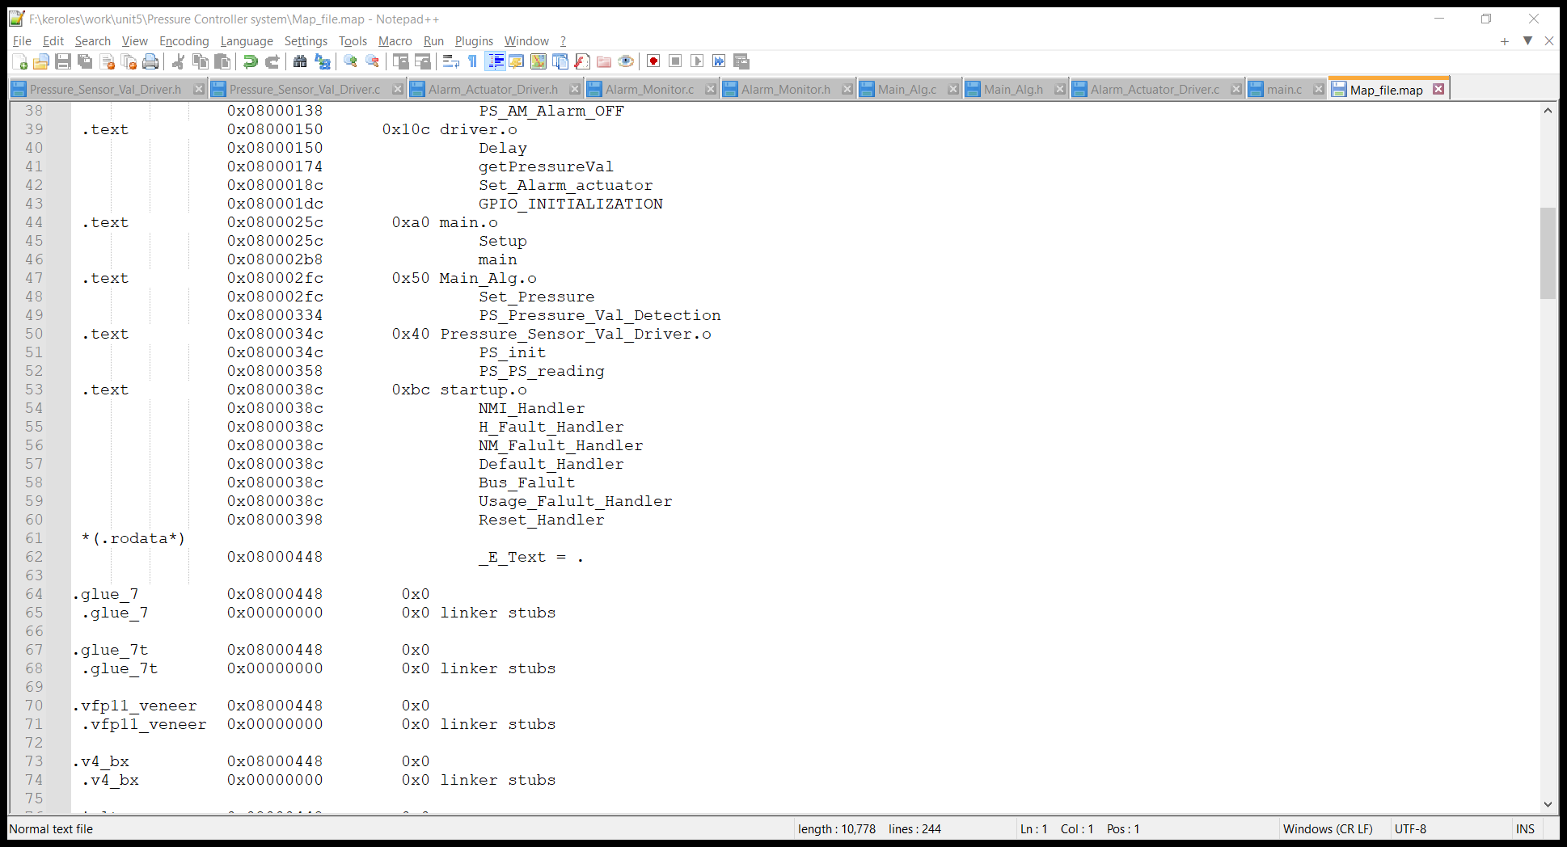
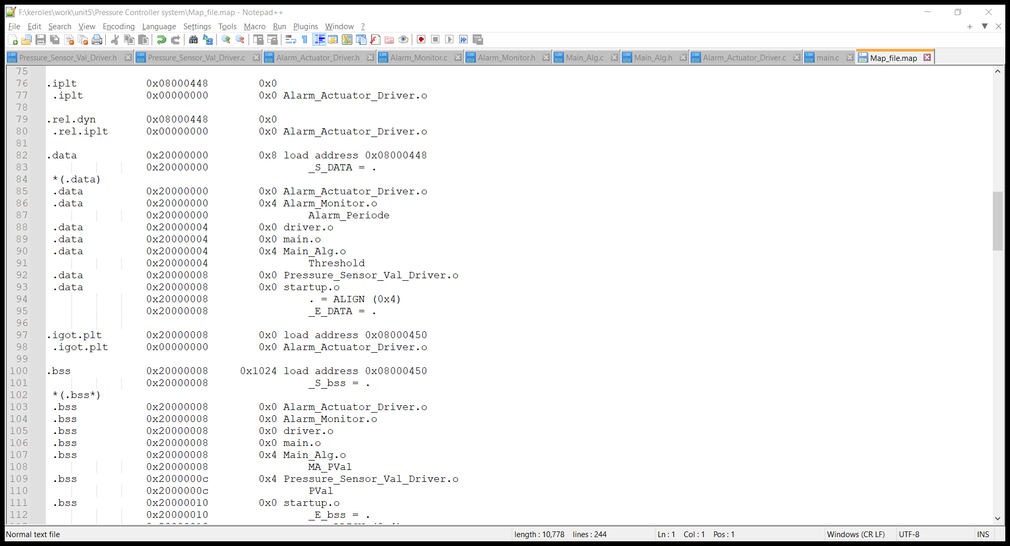
Map file

Slide 21
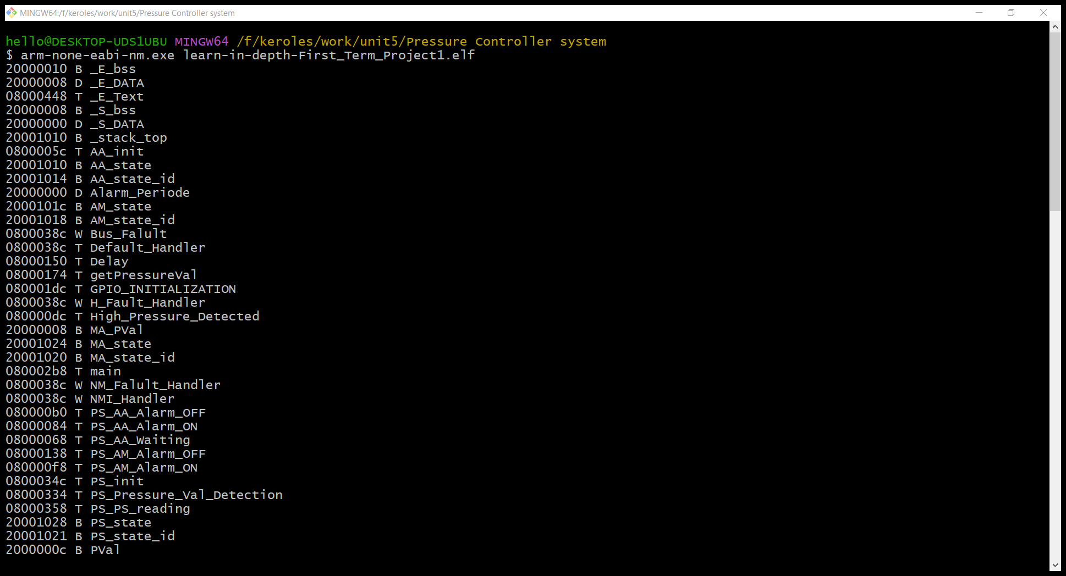
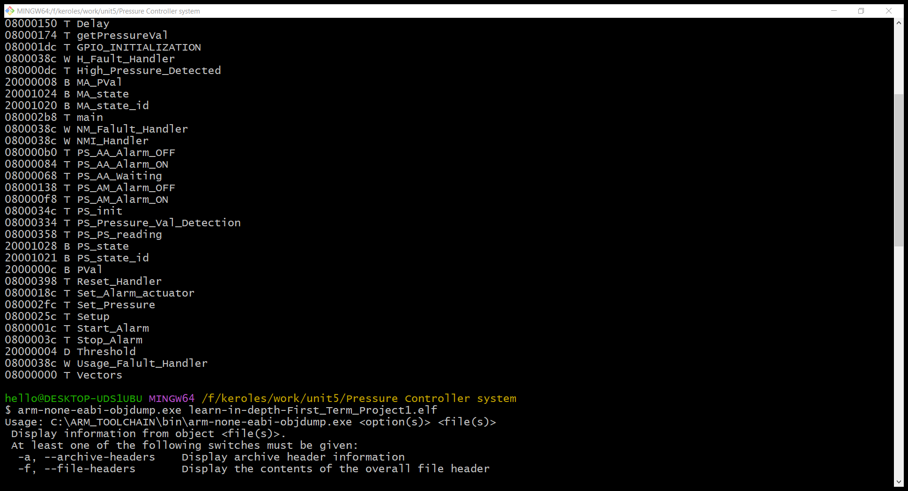
symbols table

Slide 22
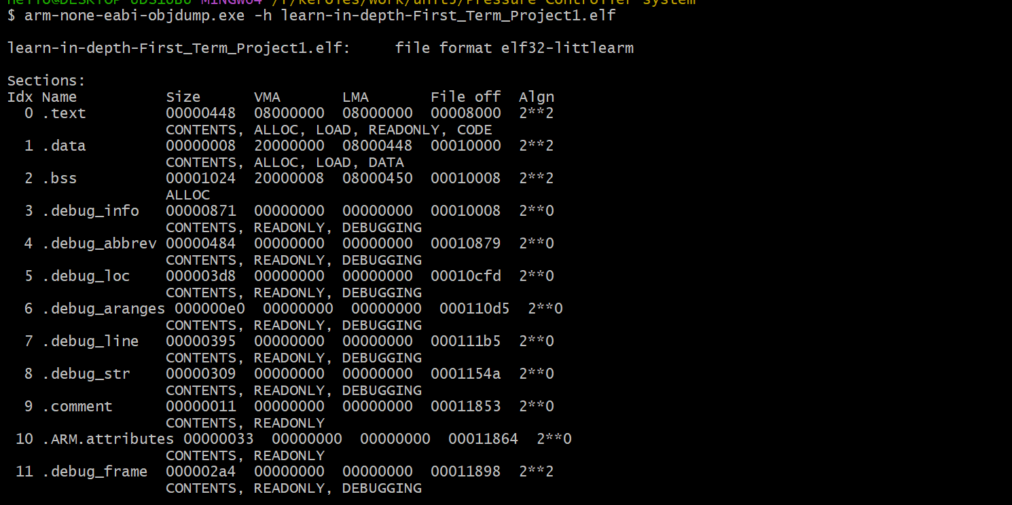
Section taples

Slide 23
Thank you ☺

